Slide 1
MOBILE UI

Slide 2
MOBILE ECOSYSTEM
This chapter looks at some of the clouds in the sky and how each part plays into the ecosystem as a whole.
It also looks at how you can get started with mobile.
Think of the mobile ecosystem instead as a system of layers.
Each layer is reliant on the others to create a seamless, end-to-end experience.

Slide 3
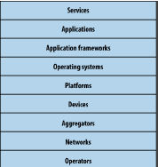
The layers of the mobile ecosystem

Slide 4
Operators
The base layer in the mobile ecosystem is the operator.
Operators can be referred to as Mobile Network Operators (MNOs).
Operators are what essentially make the entire mobile ecosystem work.
The operator’s role in the ecosystem is to create and maintain a specific set of wireless services over a reliable cellular network

Slide 5
Networks
Operators operate wireless networks. Remember that cellular technology is just a radio that receives a signal from an antenna. The type of radio and antenna determines the capability of the network and the services you can enable on it.

Slide 6

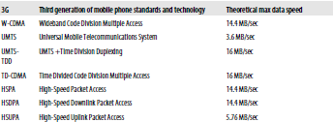
GSM mobile network evolutions

Slide 7
Devices
Smartphones make up a small sliver of worldwide market share and maintain a healthy percentage in the United States and the European Union;
smartphone market share is growing with the introduction of the iPhone and devices based on the Android platform. As next-generation devices become a reality, the distinction between feature phones and smartphones will go away.
In the next few years, feature phones will largely be located in emerging and developing markets.

Slide 8
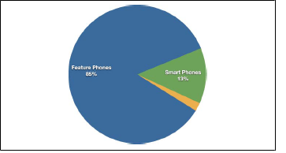
Breakdown of devices

Slide 9
Platforms
A mobile platform’s primary duty is to provide access to the devices. To run software and services on each of these devices, you need a platform, or a core programming language in which all of your software is written. Like all software platforms, these are split into three categories: licensed, proprietary, and open source.

Slide 10
Licensed
Licensed platforms are sold to device makers for nonexclusive distribution on devices. The goal is to create a common platform of development Application Programming Interfaces (APIs) that work similarly across multiple devices with the least possible effort required to adapt for device differences, although this is hardly reality
Java Micro Edition (Java ME)
Binary Runtime Environment for Wireless (BREW)
Windows Mobile
LiMo

Slide 11
Proprietary
Proprietary platforms are designed and developed by device makers for use on their devices.
Palm
BlackBerry
iPhone

Slide 12
Open Source
Open source platforms are mobile platforms that are freely available for users to download, alter, and edit.
Android is one of these platforms.

Slide 13
Operating Systems
It used to be that if a mobile device ran an operating system, it was most likely considered a smartphone.
Although not all phones have operating systems, the following are some of the most common:
Symbian , Windows Mobile, Palm OS, Linux , Mac OS X, Android

Slide 14
Application Frameworks
Application frameworks often run on top of operating systems, sharing core services such as communications, messaging, graphics, location, security, authentication, and many others.
Java
S60
BREW
Flash Lite
Web Runtimes (WRTs)

Slide 15
Applications
Application frameworks are used to create applications, such as a game, a web browser, a camera, or media player. Although the frameworks are well standardized, the devices are not. The largest challenge of deploying applications is knowing the specific device attributes and capabilities.

Slide 16
Services
Services include tasks such as accessing the Internet, sending a text message, or being able to get a location—basically, anything the user is trying to do.

Slide 17
Types of Mobile Applications
SMS
Pros
They work on any mobile device nearly instantaneously.
• They’re useful for sending timely alerts to the user.
• They can be incorporated into any web or mobile application.
• They can be simple to set up and manage.
Cons
• They’re limited to 160 characters.
• They provide a limited text-based experience.
• They can be very expensive.

Slide 18
Mobile Websites
Pros
• They are easy to create, maintain, and publish.
• They can use all the same tools and techniques you might already use for desktop sites.
• Nearly all mobile devices can view mobile websites.
Cons:
• They can be difficult to support across multiple devices.
• They offer users a limited experience.
• Most mobile websites are simply desktop content reformatted for mobile devices.
They can load pages slowly, due to network latency.

Slide 19
Mobile Web Widgets
Pros
• They are easy to create, using basic HTML, CSS, and JavaScript knowledge.
• They can be simple to deploy across multiple handsets.
• They offer an improved user experience and a richer design, tapping into device features and offline use.
Cons
• They typically require a compatible widget platform to be installed on the device.
• They cannot run in any mobile web browser.
• They require learning additional proprietary, non-web-standard techniques.

Slide 20
Mobile Web Applications
Pros
• They are easy to create, using basic HTML, CSS, and JavaScript knowledge.
• They are simple to deploy across multiple handsets.
• They offer a better user experience and a rich design, tapping into device features and offline use.
• Content is accessible on any mobile web browser.
Cons
• The optimal experience might not be available on all handsets.
• They can be challenging (but not impossible) to support across multiple devices.
• They don’t always support native application features, like offline mode, location lookup, filesystem access, camera, and so on.

Slide 21
Native Applications
Pros
• They offer a best-in-class user experience, offering a rich design and tapping into device features and offline use.
• They are relatively simple to develop for a single platform.
• You can charge for applications.
Cons
• They cannot be easily ported to other mobile platforms.
• Developing, testing, and supporting multiple device platforms is incredibly costly.
• They require certification and distribution from a third party that you have no control over.
• They require you to share revenue with the one or more third parties.

Slide 22
Games
Pros
• They provide a simple and easy way to create an immersive experience.
• They can be ported to multiple devices relatively easily.
Cons
• They can be costly to develop as an original game title.
• They cannot easily be ported to the mobile web.

Slide 23
Mobile Information Architecture
• The structural design of shared information environments .
• The combination of organizations, labeling, search, and navigation systems within websites and intranets.
• The art and science of shaping information products and experiences to support usability and findability .
• An emerging discipline and community of practice focused on bringing principles of design and architecture to the digital landscape.

Slide 24
Information architecture
The organization of data within an informational space. In other words, how the user will get to information or perform tasks within a website or application.
Interaction design
The design of how the user can participate with the information present, either in a direct or indirect way, meaning how the user will interact with the website of application to create a more meaningful experience and accomplish her goals.
Information design The visual layout of information or how the user will assess meaning and direction given the information presented to him.
Navigation design The words used to describe information spaces; the labels or triggers used to tell the users what something is and to establish the expectation of what they will find.
Interface design The design of the visual paradigms used to create action or understanding.

Slide 25
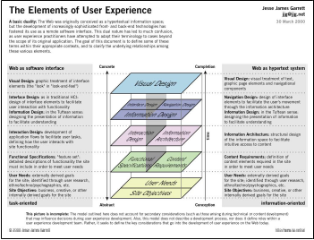

Slide 26
Mobile Information Architecture
Keeping It Simple
Site Maps
  The first deliverable we use to define mobile information architecture is the site map. Site maps are a classic information architecture deliverable. They visually represent the relationship of content to other content and provide a map for how the user will travel through the informational space

Slide 27
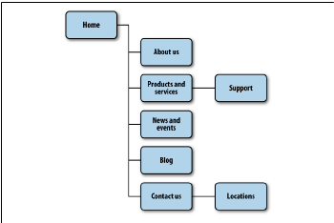

Slide 28
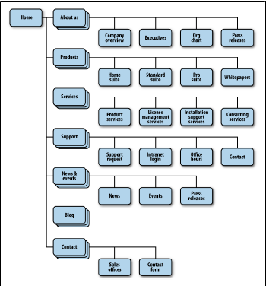
Limit opportunities for mistakes
An example of a bad mobile information architecture that was designed with desktop users in mind rather than mobile users

Slide 29
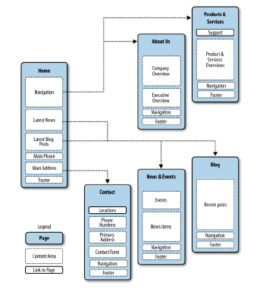
Confirm the path by teasing content

Slide 30
Clickstreams

Slide 31
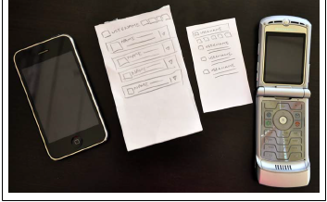
Prototyping
Paper prototypes taking our printed-out wireframes or even drawings of our interface

Slide 32
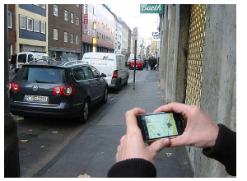
Context prototype
Take a higher-end device that enables you to load full-screen images on it.

Slide 33
HTML prototypes
The third step is creating a lightweight, semi-functional static prototype using XHTML, CSS, and JavaScript, if available.
This is a prototype that you can actually load onto a device and produce the nearest experience to the final product, but with static dummy content and data.
It takes a little extra time, but it is worth the effort.

Slide 34
Mobile Design
The Elements of Mobile Design
Context
• Who are the users? What do you know about them? What type of behavior can you assume or predict about the users?
• What is happening? What are the circumstances in which the users will best absorb the content you intend to present?

Slide 35
• When will they interact? Are they at home and have large amounts of time? Are they at work where they have short periods of time? Will they have idle periods of time while waiting for a train, for example?
• Where are the users? Are they in a public space or a private space? Are they inside or outside? Is it day or is it night?
• Why will they use your app? What value will they gain from your content or services in their present situation? • How are they using their mobile device? Is it held in their hand or in their pocket? How are they holding it? Open or closed? Portrait or landscape?

Slide 36
Message
what you are trying to say about your site or application visually.
Look and Feel
Look and feel is used to evoke action—how the user will use an interface.

Slide 37
Layout
Layout is an important design element, because it is how the user will visually process the page, but the structural and visual components of layout often get merged together, creating confusion and making your design more difficult to produce

Slide 38
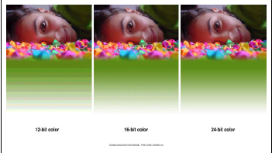
Color
The fifth design element, color, is hard to talk about in a black-and-white book.
These days, we have nearly the entire spectrum of colors to choose from for mobile designs.

Slide 39
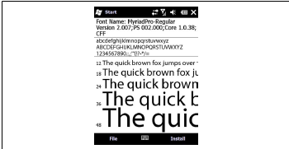
Typography
Traditionally in mobile design, you had only one typeface that you could use and that was the device font. The only control over the presentation was the size.

Slide 40
Graphics
The final design element is graphics, or the images that are used to establish or aid a visual experience. Graphics can be used to supplement the look and feel, or as content displayed inline with the text.

Slide 41
Mobile 2.0
Mobile is already a medium, but the consensus is that by leveraging the power of the Web, integrating web services into the mobile medium is the future of mobile development.
When the iPhone exploded onto the scene, it increased the usage of the mobile web by its users to levels never seen before.
The spur of new mobile web apps created just for the iPhone doubled the number of mobile websites available in under a year.
If Web 2.0 taught us that the Web is the platform, then Mobile 2.0 tells us that mobile will be the primary context in which we leverage the Web in the future.

